Slide 1








Lesson 1. Angular 4 Routing

Slide 2
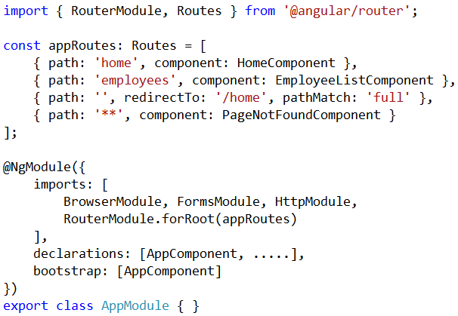
Angular Routing Tutorial
Step 2 : Import RouterModule and define routes

Slide 3
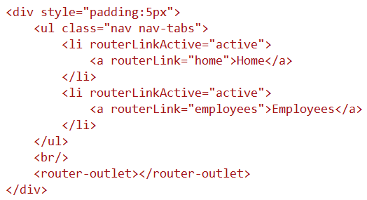
Angular Routing Tutorial
Step 3 : Tie the routes to application menu
Bootstrap nav component : Bootstrap

Slide 4
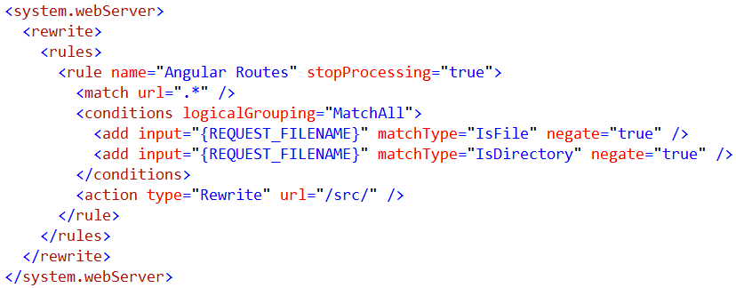
Angular Routing Tutorial
Step 4 : In web.config include the following url-rewrite rule

Slide 5
Q & A
Contact:rashmipawaskar@synergetics-india.com

Slide 6
Thank You

